Slide 1

Urba Ali Awan
STUDENT OF CIT
Week 4

Slide 2

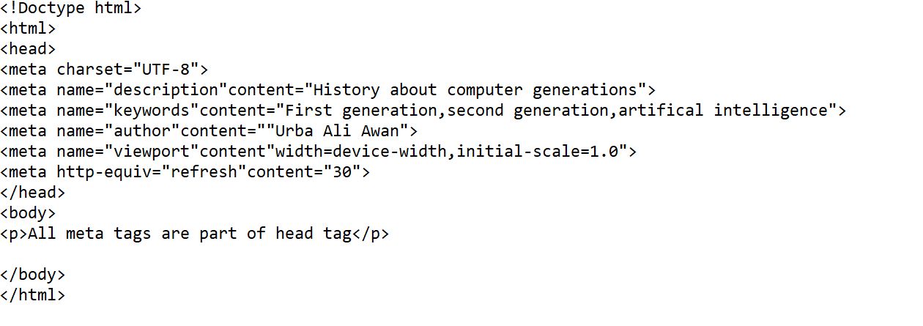
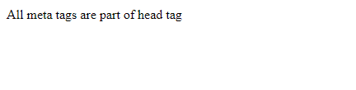
Meta Tags
Example:
Why we use meta tag in html?
Metadata is data (information) about data.
The <meta> tag provides metadata about the HTML document. Metadata will not be displayed on the page.
Output

Slide 3

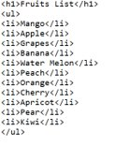
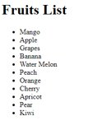
Unorder List
Example:
Output
<ul>----<li>---</li></ul>
Why we use ul tag in html?
the ul element is used to define an unordered list of items it is useful for creating bulleted list.

Slide 4

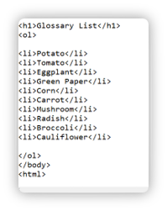
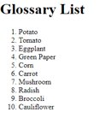
Order List
Example:
<ol>----<li>---</li></ol>
Why we use ol tag in html?
The ol tag defines an ordered list.
Li is used to include items in a list.
Output

Slide 5

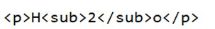
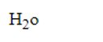
Sub
Example:
<sub>---</sub>
Why we use sub tag in html?
Subscript text can be used for chemical formulas, like H2O.
Output

Slide 6

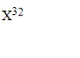
Sup
Example:
<sup>---</sup>
Why we use sup tag in html?
Superscript text can be used for mathematics.
Output

Slide 7

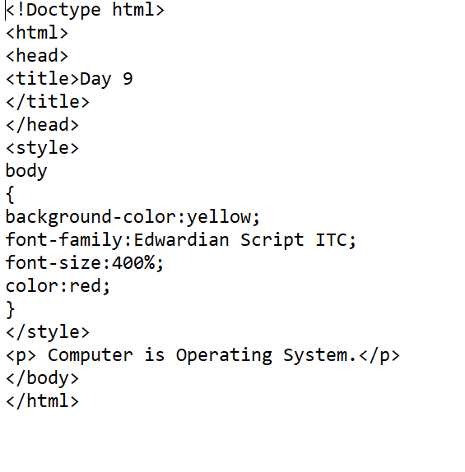
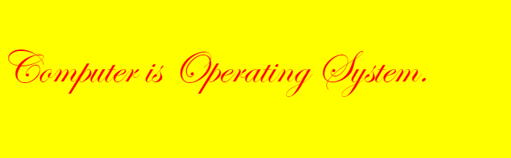
Background and Font color
Example:
The <font> tag was used in HTML 4 to specify the font face, font size, and color of text.
The HTML <body> background Attribute is used to specify the background-image for the document.
Output

Slide 8

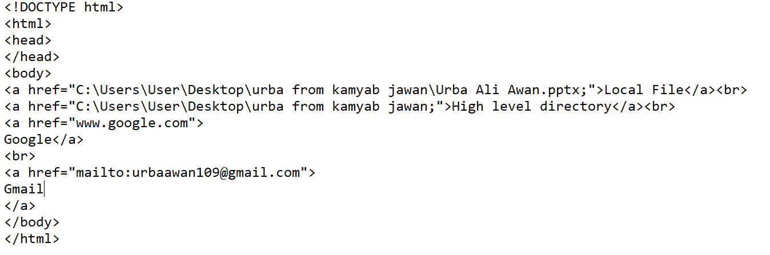
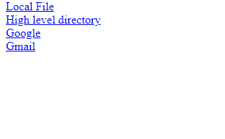
<a>href
Example:
<a href>-----</a>
Why we use a tag in html?
You can use the <a> tag to link text or images.
Output

Slide 9
Thank You!

